Slide 1

Discussion on Turing’s Computing Machinery and Intelligence

Slide 2
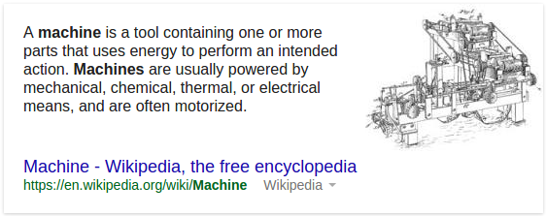
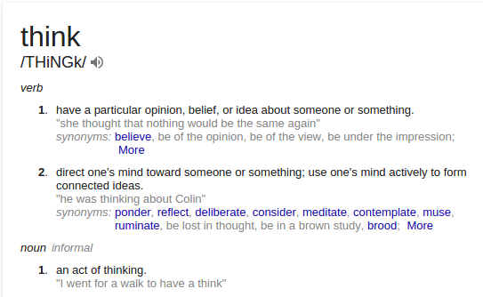
Can machines think?

Slide 3
Can machines think?
Meaning and answer can not be found by analyzing their definitions
∵
proposes the imitation game

Slide 4





The imitation game

Slide 5

The new imitation game

Slide 6
The new imitation game

Slide 7
The new question then …
Will the interrogator decided wrongly as often when the game is played between a man and woman, as they do when the game is played between a man (or woman) and a machine?
This replaces the original question: Can machines think?

Slide 8
Advantage of new game
“This new problem has the advantage of drawing a fairly sharp line between the physical and the intellectual capacities of a man.”
What does Turing mean by this?
We are only considering the intellectual capabilities of a human in this new problem

Slide 9
Advantage of the machine
Would there be an advantage for the machine to be something other than an imitation of the behavior of a human?
Turing does not believe so and believes that it will be
assumed that the best strategy is to try and provide
answers that would naturally be given by a man
What do you think? ….
Not all human’s write sonnets but some do …

Slide 10
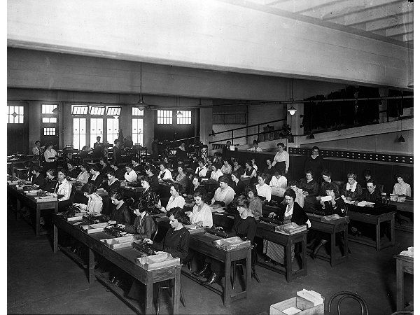
Digital computer
The idea behind the digital computer is that it is intended to carry out any operations which could be done by a human computer
Teams of people who were used to undertake long and often tedious calculations
The work was divided so it could be done in parallel

Slide 11
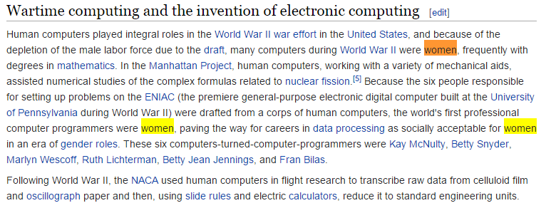
Human computer

Slide 12
Computer with free will
Digital computer with a random element
One of the instructions involves throwing a die to determine which instruction to follow
Is this free will?

Slide 13

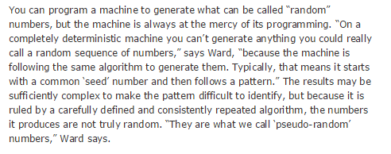
Are random numbers really random?

Slide 14
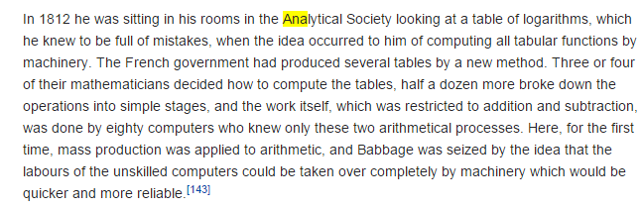
The Analytical Engine
Charles Babbage: Lucasian Professor Mathematics, Cambridge from 1828 – 1839
The Analytical Engine was mechanical not digital; the essential idea was there.

Slide 15
Objections to “Can machine’s think”

Slide 16
Objections to “Can machine’s think”
The Theological Objection:
‘Heads in the Sand’ Objection:
Argument from Continuity in the Nervous System:
The Mathematical Objection:
The Argument from Consciousness:
The Lady Lovelace Objective
Arguments from Various Disabilities:
The Argument from Informality of Behavior:
The Argument of ESP

Slide 17
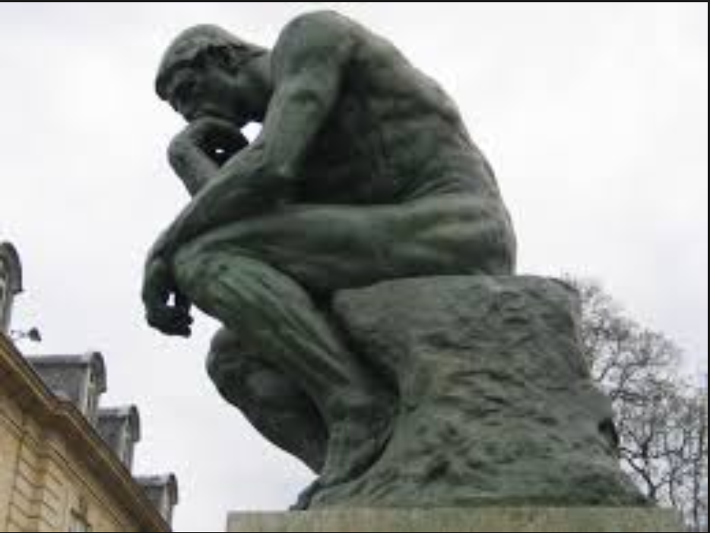
The Theological Objection
Thinking is a function of man’s immortal soul

Slide 18

Heads in the Sand Objection
The consequences of machines thinking is to dreadful to even consider

Slide 19
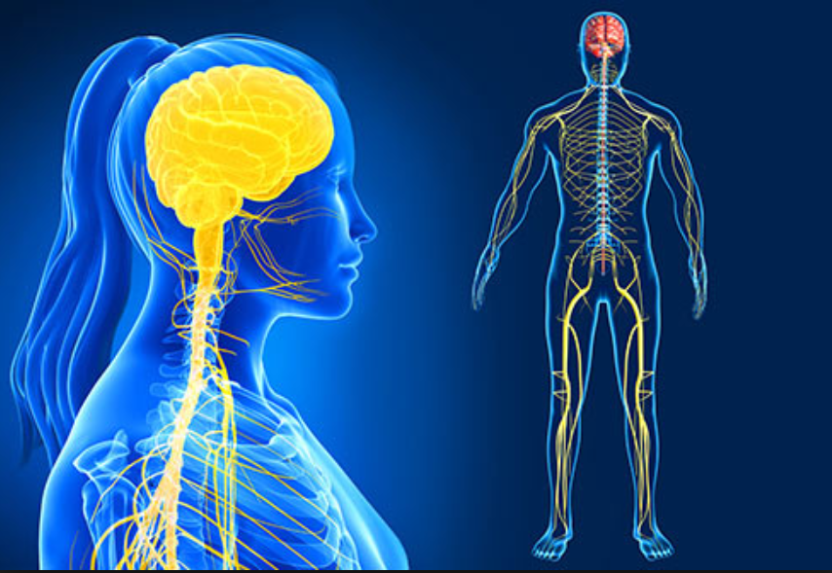
Argument from Continuity in the Nervous System
a discrete state machine can not mimic the nervous system

Slide 20
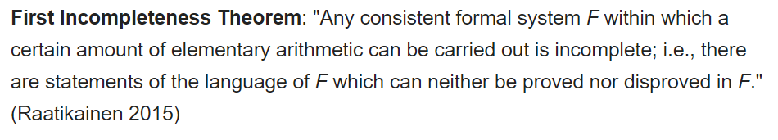
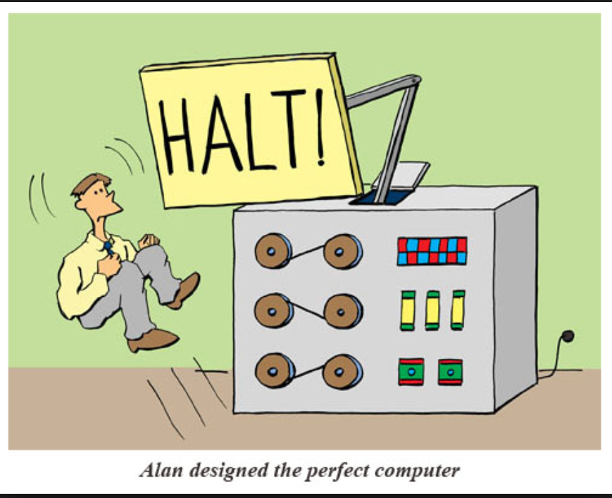
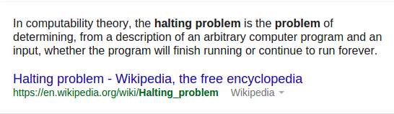
The Mathematical Objection
Mathematical logic which can be used to show that there are limitations to the powers of discrete state machines

Slide 21
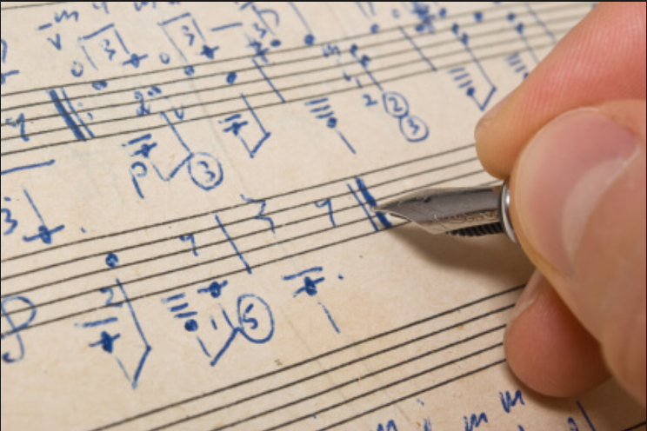
The argument of consciousness
‘Not until a machine can write a sonnet or compose a concerto …’

Slide 22
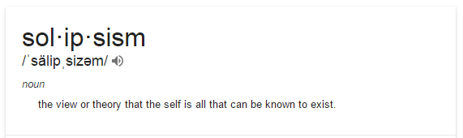
The Argument from Consciousness
Argument: “Not until a machine can write a sonnet or compose a concerto because of thoughts and emotions felt, and not by the chance fall of symbols, could we agree that machine equals brain – that is not only write it but know that it had written it” – Professor Jefferson
Counter:
If
To know if a machine is
thinking, one needs to be a machine
then
To know if a particular man is thinking,
one needs to be that man

Slide 23

Arguments from Various Disabilities
You can’t make a machine do X.
Where X =
Be kind
Be resourceful
Be beautiful
Be friendly
Have initiative
Have a sense of humour
Tell right from wrong
Make mistakes
Fall in love
Enjoy strawberries and cream
Make someone fall in love with it
Learn from experience
Use words properly
Be the subject of its own thought
Do something new

Slide 24
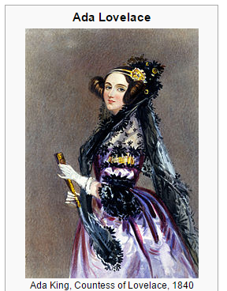
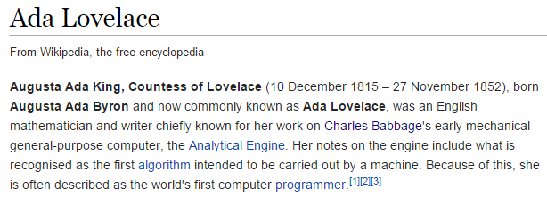
Lady Lovelace’s Objection
The computer has no pretension to originate anything. I can do whatever we know how to order it to perform.
Basically
Machines can never do anything new

Slide 25
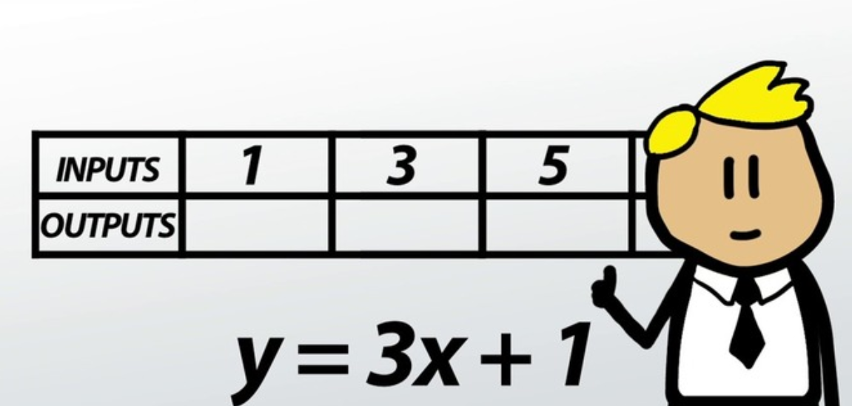
Argument from Informality of Behaviour
can not produce a set of rules describing what man should do for all sets of circumstances

Slide 26
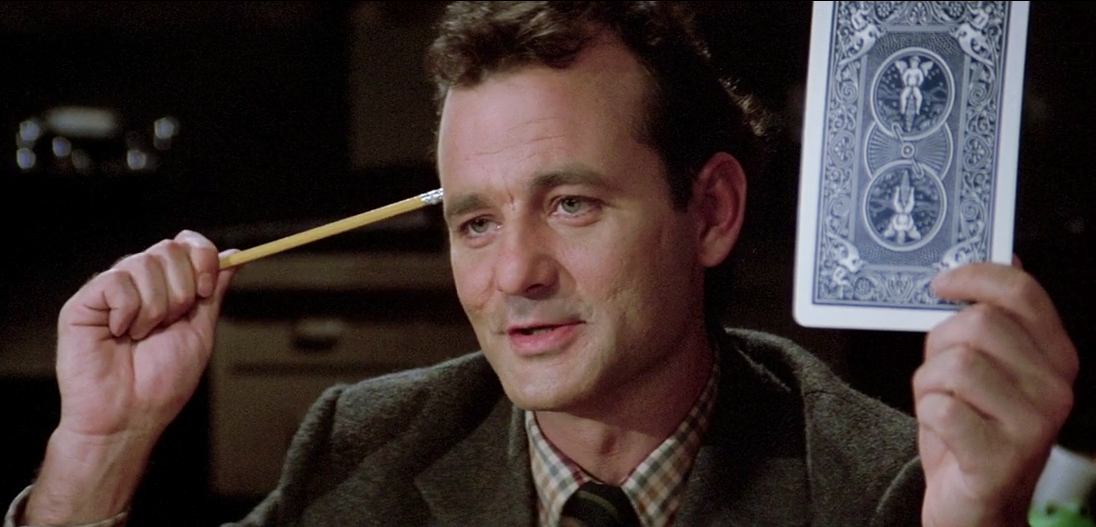
The Argument from Extra Sensory Perception

Slide 27


Who are you going to call…

Slide 28
Searle’s Response

Slide 29
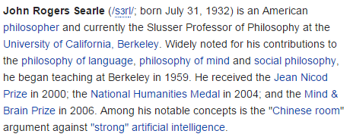
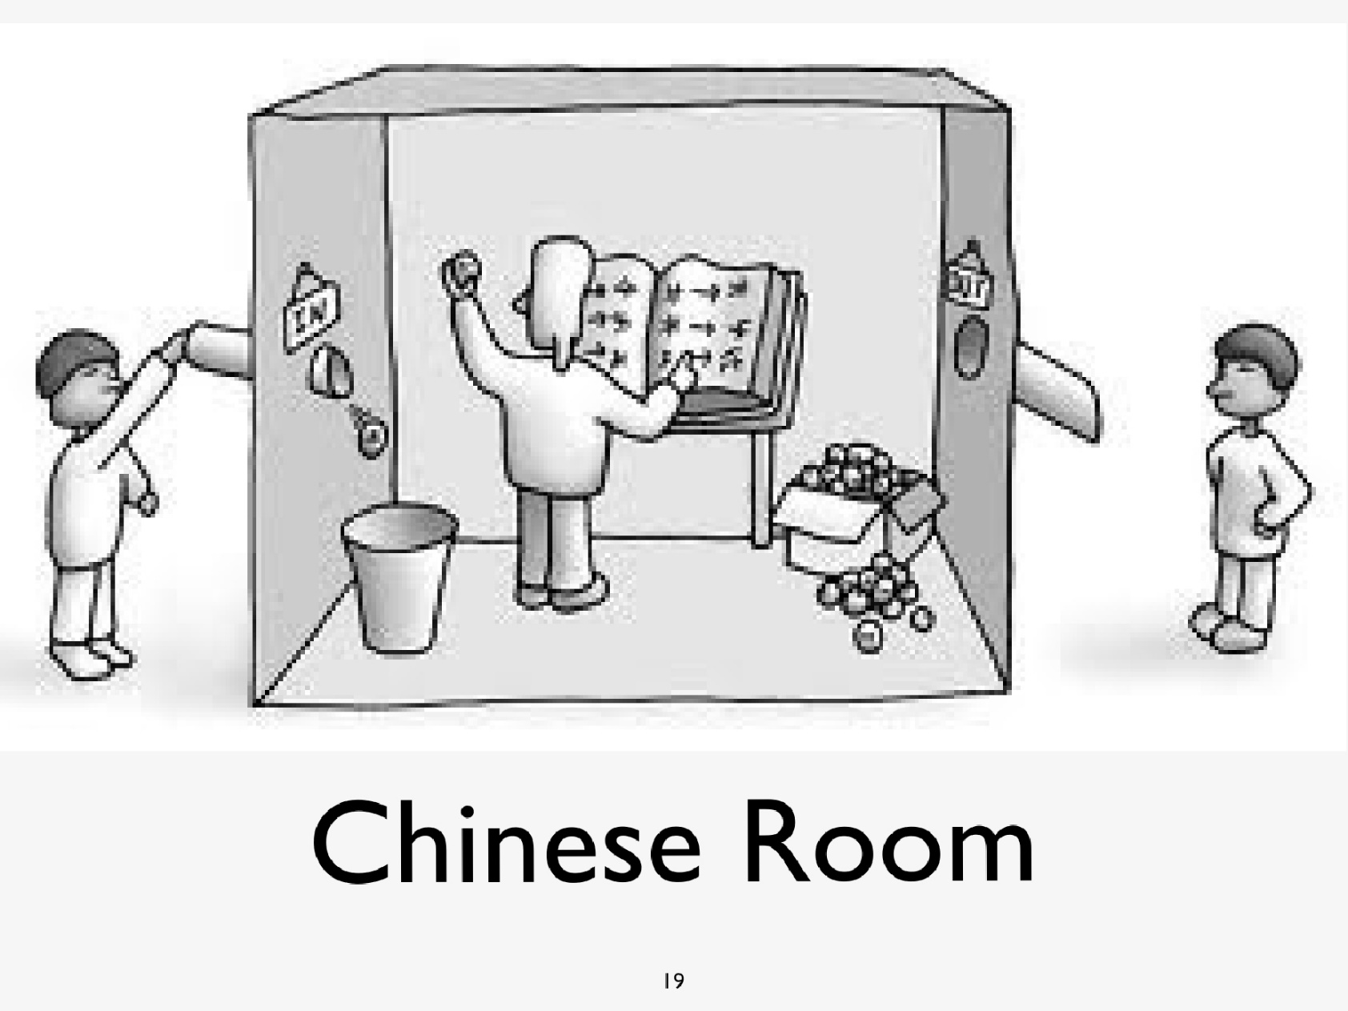
Searle: Chinese Room Theory
Does the man in the room really know Chinese?

Slide 30
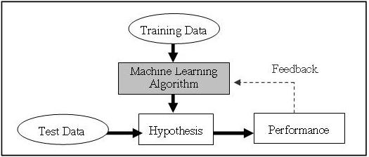


Learning Machines
Can we teach a computer to learn …
Interesting question now a days with the prevalence of ‘machine learning’ algorithms
What does Learning mean?
Think about how children learn
Training Data?

Slide 31
What are the best ones to start with?
Difficult decision
Get the computer to play chess

Slide 32
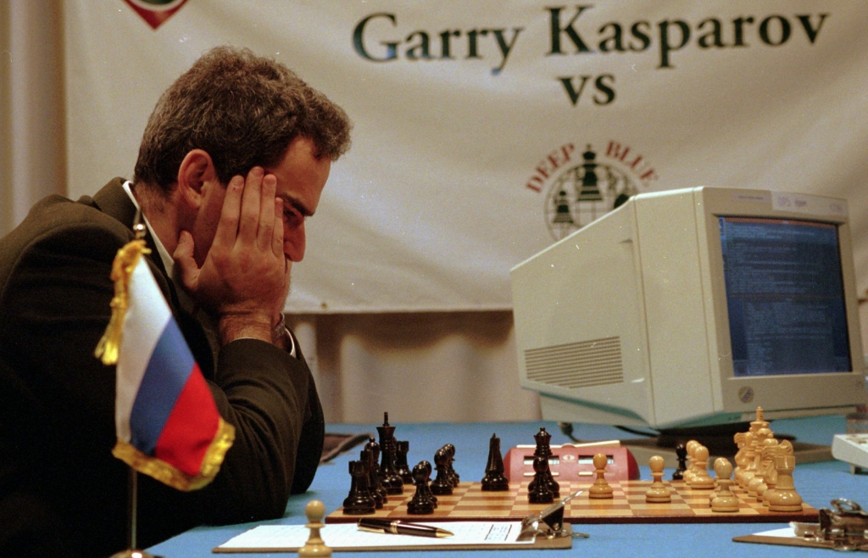
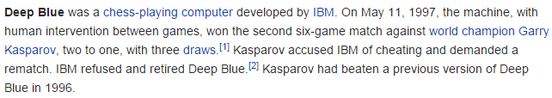
What are the best ones to start with?
Difficult decision
Get the computer to play chess

Slide 33
What are the best ones to start with?
Difficult decision
Get the computer to play chess
Teach it to understand and speak English

Slide 34
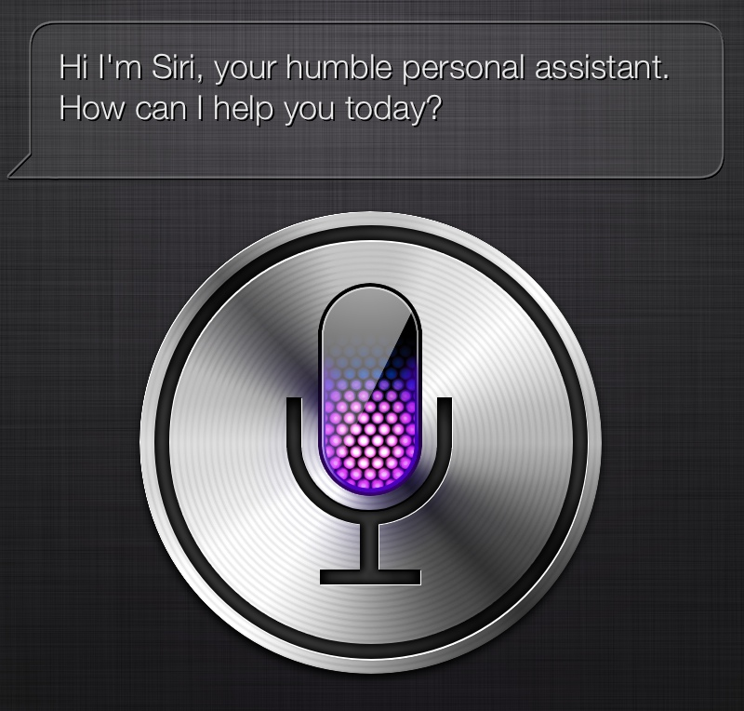
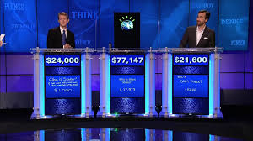
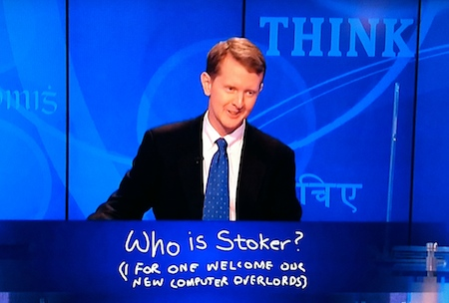
What are the best ones to start with?
Difficult decision
Get the computer to play chess
Teach it to understand and speak English

Slide 35
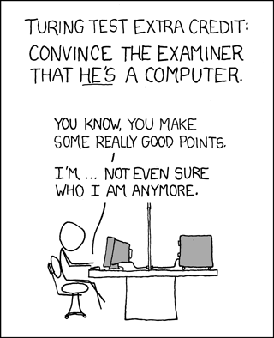
Questions, Comments …

Slide 36
Next Up
Wednesday
Formal Languages
Friday
Wilks’ Companionable Agents

